Slide 1
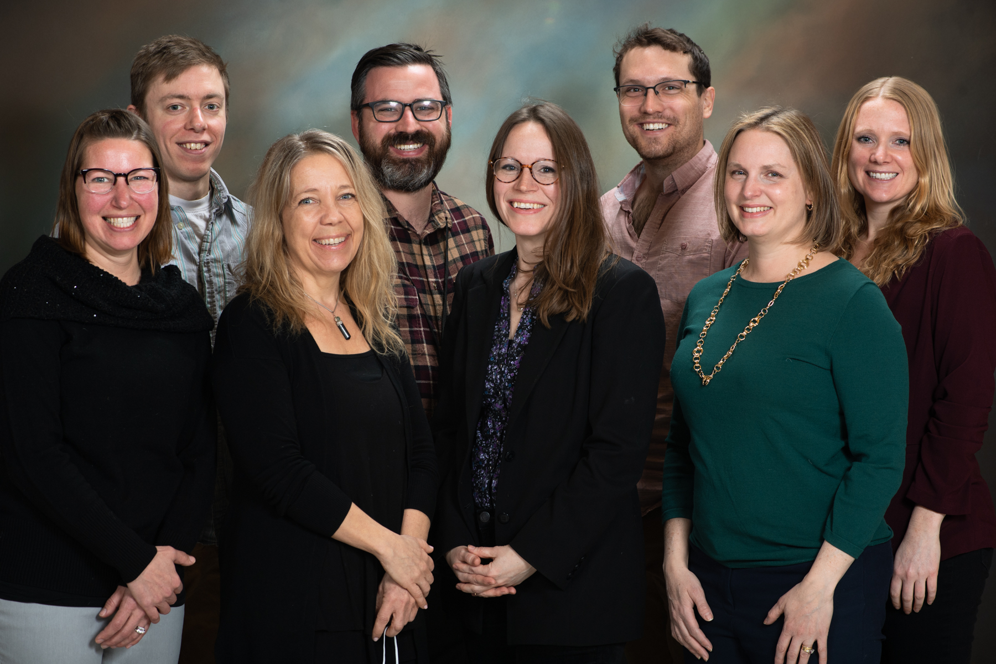
Center for Care Delivery and Outcomes Research (CICenter for Care Delivery and Outcomes Research Health Services Research (HSR) Fellowship Expert & Stakeholder Forum
1

Slide 2
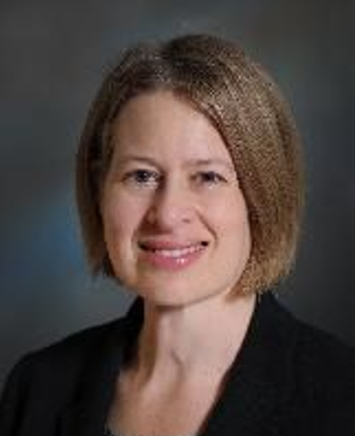
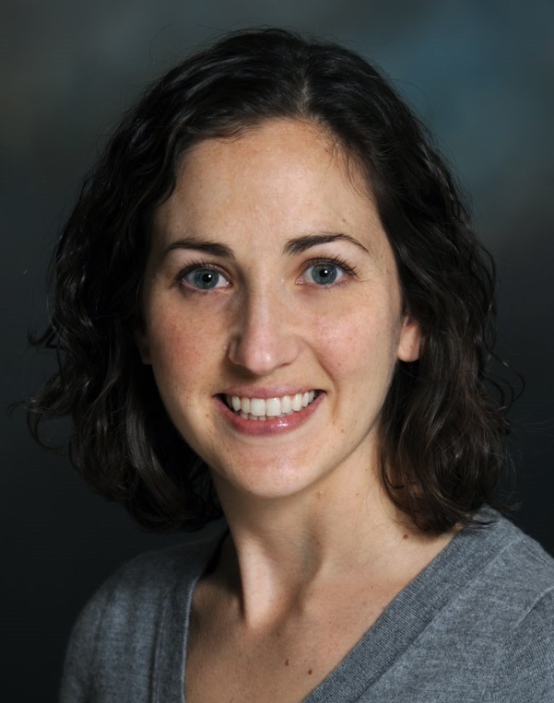
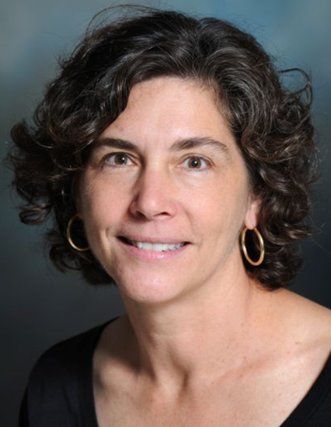
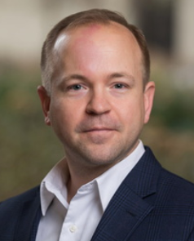
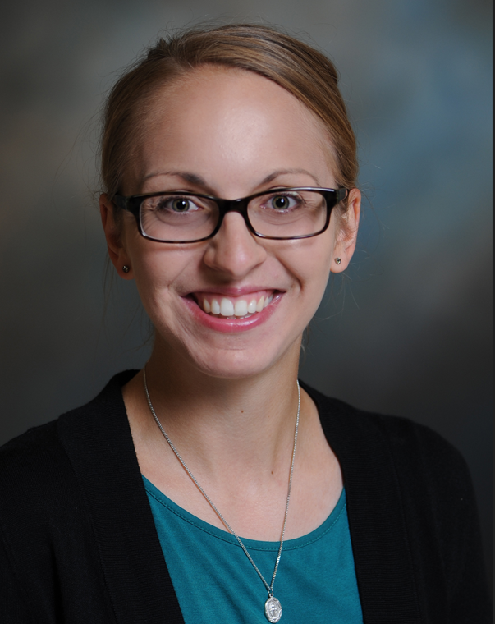
Fellowship Leadership Structure
Director
Diana Burgess, PhD
Co-Director
Elisheva Danan, MD, MPH
Associate Director
Michele Spoont, PhD
Associate Director of Curriculum
Nathan Shippee, PhD
Fellowship Coordinator
Brittany Majeski, BA

Slide 3
CCDOR-HSR Fellowship Program
Our HSRD Fellowship was successfully refunded through a competitive recompete in FY21
Two-year postdoctoral fellowship for physicians, associated health or nursing professionals, and those with a PhD or equivalent in health services research, public health, social sciences, or statistics.
Fellows spend 80% of their time in research and education and 20% in clinical care (or health care system improvement activities for non-clinicians) at the Minneapolis VA Health Care System.
All fellows are paired with a Primary Research Mentor, selected from a talented cadre of CCDOR investigators, and an Operations Mentor. Operations Mentors are clinical or operational leaders who will help fellows address high priority research questions, navigate systems barriers to change, and ultimately conduct more impactful research.

Slide 4
Mentoring
Fellows complete an annual training plan and progress review with their mentors to discuss and refine fellowship goals in the following content areas.
Foundational HSR (health services research) and LHS (Learning Health Systems) competencies; Knowledge in target research area
Knowledge of priorities of VA operations (e.g., systematic review, understanding IIR priority areas; webinars from operational partners)
Study design, execution, and analysis needed to become an independent investigator in target research area. Includes research proposal development such as a LIP.
Scientific communication (e.g., manuscripts, internal/external presentations, journal reviews).
LHS/Experiential learning.
Non-clinical fellows spend 20% of their time in healthcare system improvement activities

Slide 5
Expanded focus on Learning Health Systems
MVAHCS & VISN 23 leaders will facilitate opportunities for engagement in high priority LHS & QI research
Internal Advisory Board
Partnerships with QI & LHS training programs
VA Quality Scholars (VAQS)
Minnesota Learning Health Systems Career Development Program (MN-LHS)
Associate Director for Curriculum, Dr. Nathan Shippee; Director of Curriculum & Methods for MN-LHS
Innovative curriculum emphasizing experiential mentored learning, embedded research & participation in communities of practice
Operations Mentor (clinical or operational leader)
New learning opportunities through MN-LHS & UMN Center for Learning Health Systems Sciences
MN-LHS Design Shop; Applied Topics in Learning Health Systems Research
Individualized Development Plan, guided by the Learning Health Systems Competency Appraisal Inventory (LHS-CAI)

Slide 6
HSR Fellowship Program Curriculum
In FY22, the HSR Fellowship Program expanded their structured curriculum to include the following. The new curriculum is designed to address the core LHS competencies.
Required Curriculum
Fellow Implementation Science Journal Club (started October 2022)
Early-Stage Investigator (ESI) Brown Bags
Health Services Research Innovations Incubator (HSRI²) seminars
Minnesota Learning Health System Mentored Career Development Program (MN-LHS) Design Shop Seminars
CCDOR Research Seminars, All Staff Meetings, & Core PI meetings
Individual meetings with leads of Evidence Synthesis Program, Veteran Engagement Core, & Fellowship Program Leadership
Requirements to present at least one HSRI² seminar and one Medicine Research Conference/Journal Club
Requirement to conduct or observe a Veteran Engagement Panel
Optional Curriculum
Minneapolis VA
Medicine Research Conferences/Journal Club
Research Service Conferences
Medicine Grand Rounds
University of Minnesota
Center for Learning Health Systems Sciences (CLHSS) Impact Monthly Seminars
Program in Health Disparities Research (PHDR) Seminars
Center For Chronic Disease Reduction And Equity Promotion Across Minnesota (C2DREAM) seminars
T32 Cancer Health Disparities Training program activities

Slide 7
HSR Fellowship Program Curriculum continued
Local Curriculum Learning Objectives
LHS Researcher Core Competency Domains | CCDOR Research and Infrastructure Core | Example Fellow Training Opportunities
Systems Science | Mentoring and Training Core; Implementation Core | “Applied Topics in Learning Health System Research” course at UMN SPH
Research questions, and standards of scientific evidence | Evidence Synthesis Core | Participation in ESP evidence review or GRADE (Grading of Recommendations Assessment, Development and Evaluation) project
Research methods | Statistics & Data Management (SDM) Core; Evidence Synthesis Core | MN-LHS Design Shop Seminar
Informatics | Statistics & Data Management (SDM) Core | Partner with Clinical Informatics fellows to co-manage a project embedded in VA Operations (connect with Adams Dudley)
Ethics of research and implementation in health systems | Mentoring and Training Core Implementation Core | Mentored experience seeking IRB or regulatory oversight for pilot project; Fellow/ESI Lunchtime Seminars;
Improvement and Implementation Science | Implementation Core | Implementation Science Journal Club participation
Engagement, leadership, and research management | Veteran Engagement (ViEW) Core; Implementation Core; Mentoring and Training Core | Preparing and participating in ViEW panel for a study; Fellow/ESI Lunchtime Seminars
Diversity, Equity, and Inclusion | CCDOR DEI Workgroup | Program for Health Disparities Research seminar series; Health Equity Workgroup activities

Slide 9
Internal Advisory Board (IAB)
Multi-disciplinary operational leaders from the MVAHCS, senior LHS leaders and fellowship faculty
IAB Chair: Burgess
Help fellows become embedded in LHS research and QI initiatives at the MVAHCS, for research (80% time for all fellows) and healthcare system improvement initiatives (20% time for non-clinical fellows)
Provide oversight of the program and curriculum
Annual evaluation report will include fellow and faculty evaluations

Slide 10
IAB Members
Areef Ishani, MD, Medical Director for the VISN 23 Specialty Care ICC and Director, MVHAHCS Primary Care and Specialty Care ICC
Kristin Nichol, MD, MPH, MBA, Deputy Chief of Staff, MVHAHCS
Timothy Beebe, PhD, Director of MN-LHS, Deputy Director UMN Center for Learning Health Systems Sciences (CLHSS)
R. Adams Dudley, MD, MBA, CCDOR Investigator; Professor of Medicine, Informatics, and Public Health
Hildi Hagedorn, PhD, CCDOR Investigator, 2020 VA HSR&D Health System Impact Award and an internationally recognized leader in implementation science
Shahnaz Sultan MD, MHSc, UMN Department of Medicine’s Vice Chair for Diversity, Equity, and Inclusion
Genevieve Melton-Meaux, MD, PhD, Director of the UMN CLHSS

Slide 11
Embedded Research & Communities of Practice Opportunities
Facility and ICC leadership will help identify high priority QI and LHS projects and will connect fellows with Operations Mentors and leaders in the Quality, Safety, and Value (QSV) office
Affiliation with other VA training programs:
VA Quality Scholars (VAQS)
VAQS has close relationships with the QSV Office, facility executive leadership, and ICC Chiefs
Geriatric Research, Education, and Clinical Center (GRECC)
Clinical Informatics Fellowship (CIF; Joint MVAHCS and Hennepin Healthcare fellowship)
HSR Fellows may co-manage a project embedded in VA operations with CIF
Affiliation with non-VA communities of practice:
UMN NIH Clinical and Translational Science Institute (CTSI)
Minnesota Learning Health System Mentored Career Development Program (MN-LHS)
The UMN Center for Learning Health Systems Sciences (CLHSS)
Participate in the Minnesota Electronic Health Record Consortium (MN-EHRC)

